Slide 1

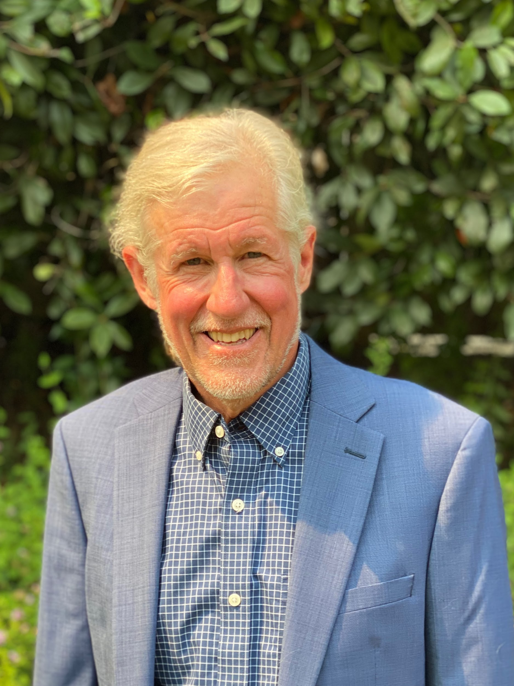

CHIPS 2022 Biannual
Technology Update
Rob Mains
General Manager
CHIPS Alliance
Email: rmains@linuxfoundation.org
Phone: +1 408 607 4879
March 12, 2022
Notes:
Hello:
My name is Rob Mains and I am general manager of CHIPS Alliance, which is part of the Linux Foundation.
As a nearly 40 year veteran in the chip development industry, with stints at IBM, Magma, Sun, Oracle, and Qualcomm,I have seen many trends and paradigms come and go, only to resurface again.. My experience covers both technical as well as executive management level stints.
Suffice to say, there have been many changes, but a continuing theme is change, particularly as it relates to innovation, productivity, cost, and time to market.
Similar as to what happened in software, open source hardware design offers new opportunities for collaboration, innovation, and product creation.
CHIPS Alliance has pillars of interest and associated workgroups across architecture, specification, reference implementation, interconnect, tools, FPGA, analog, verification, and artificial intelligence. Groups can spin up or down depending upon the challenges ahead.
Many ask what does my company have to provide in terms of IP. You don’t have to.
In fact, the level of participation is up to you, and can be done without even being a member of CHIPS. Our goal is to encourage collaboration.

Slide 2
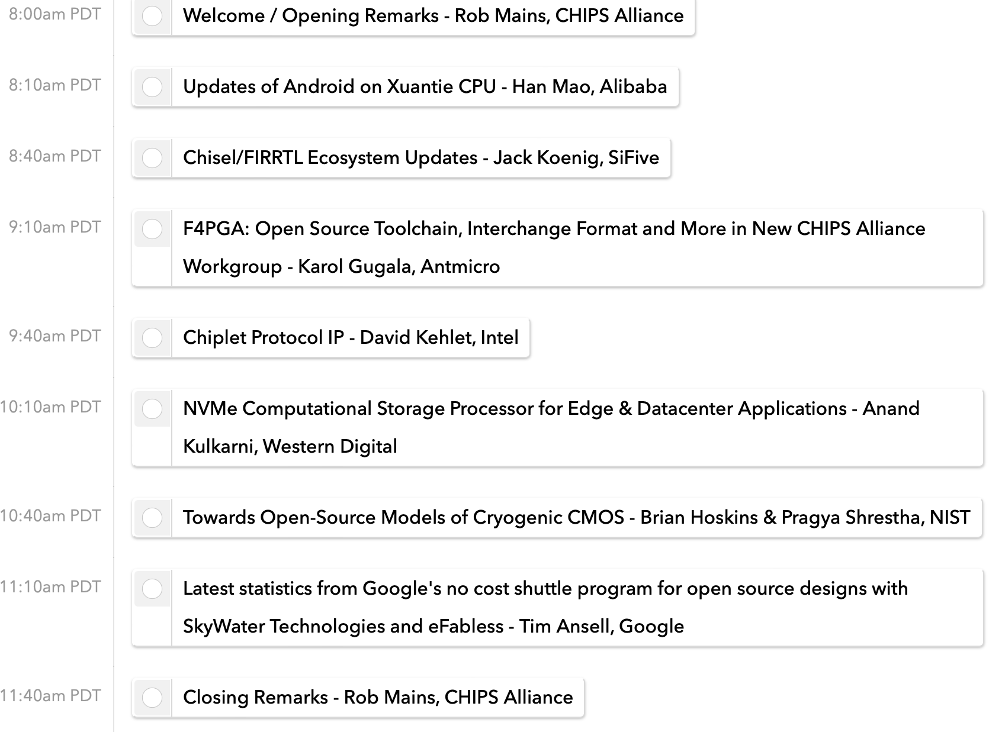
Technology Update Agenda

Slide 3
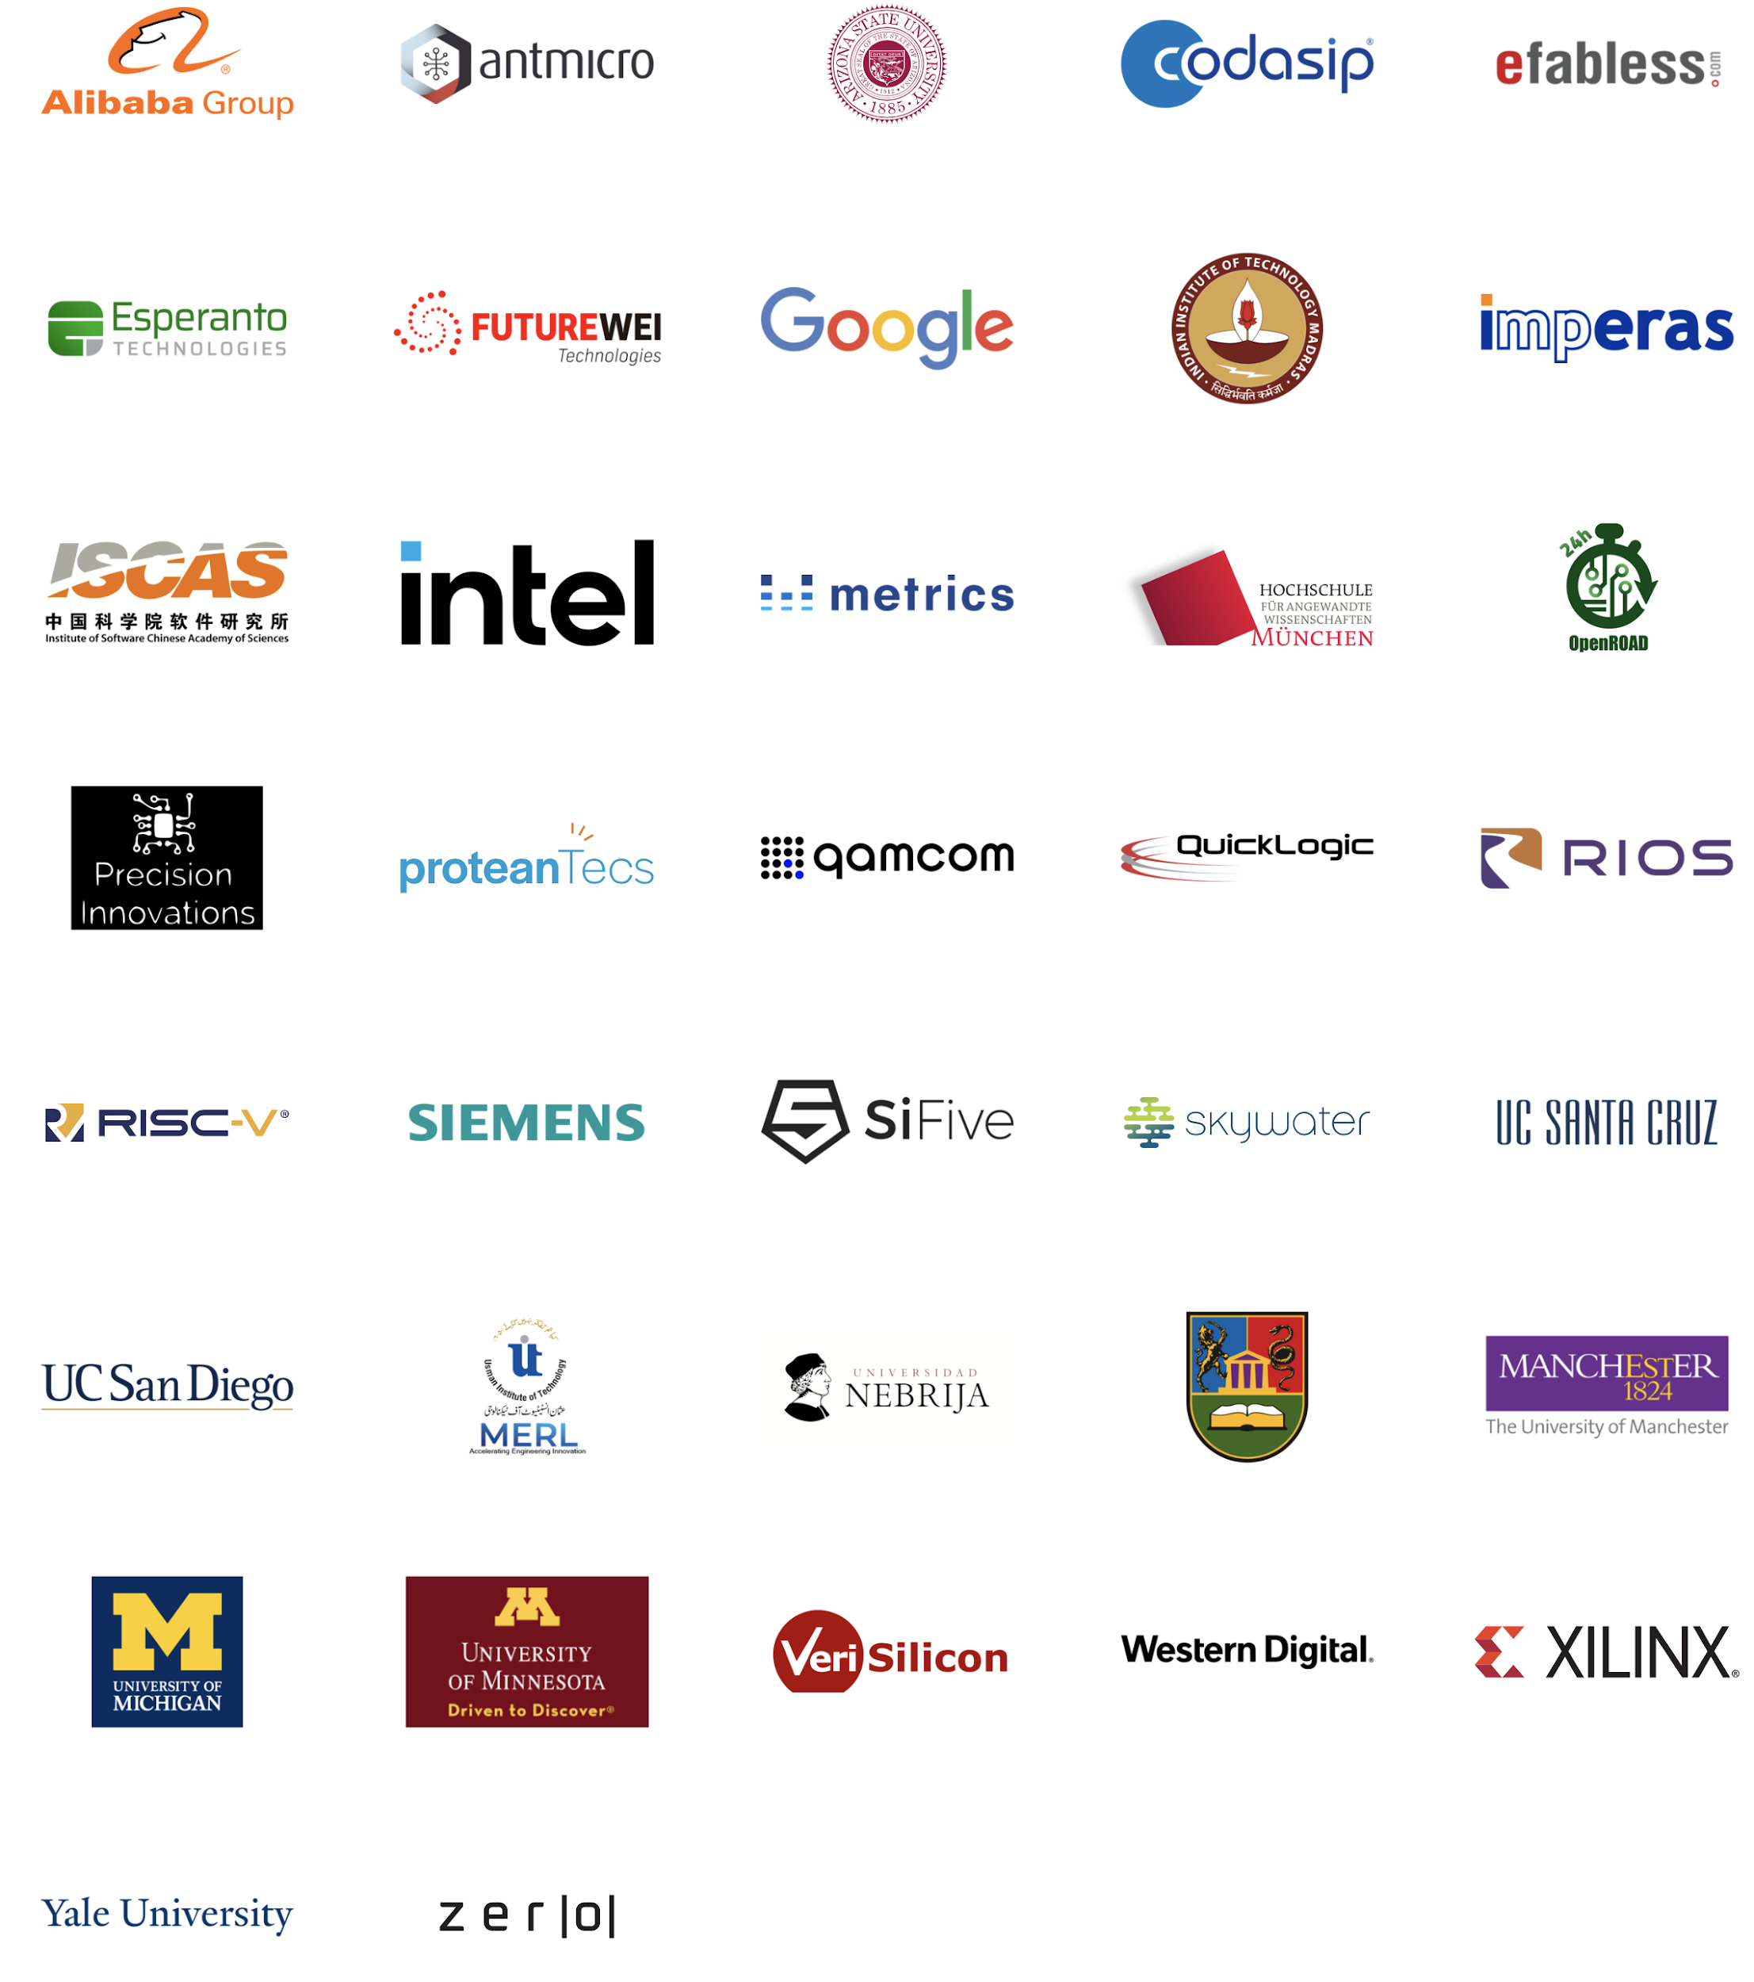
Members

Slide 4
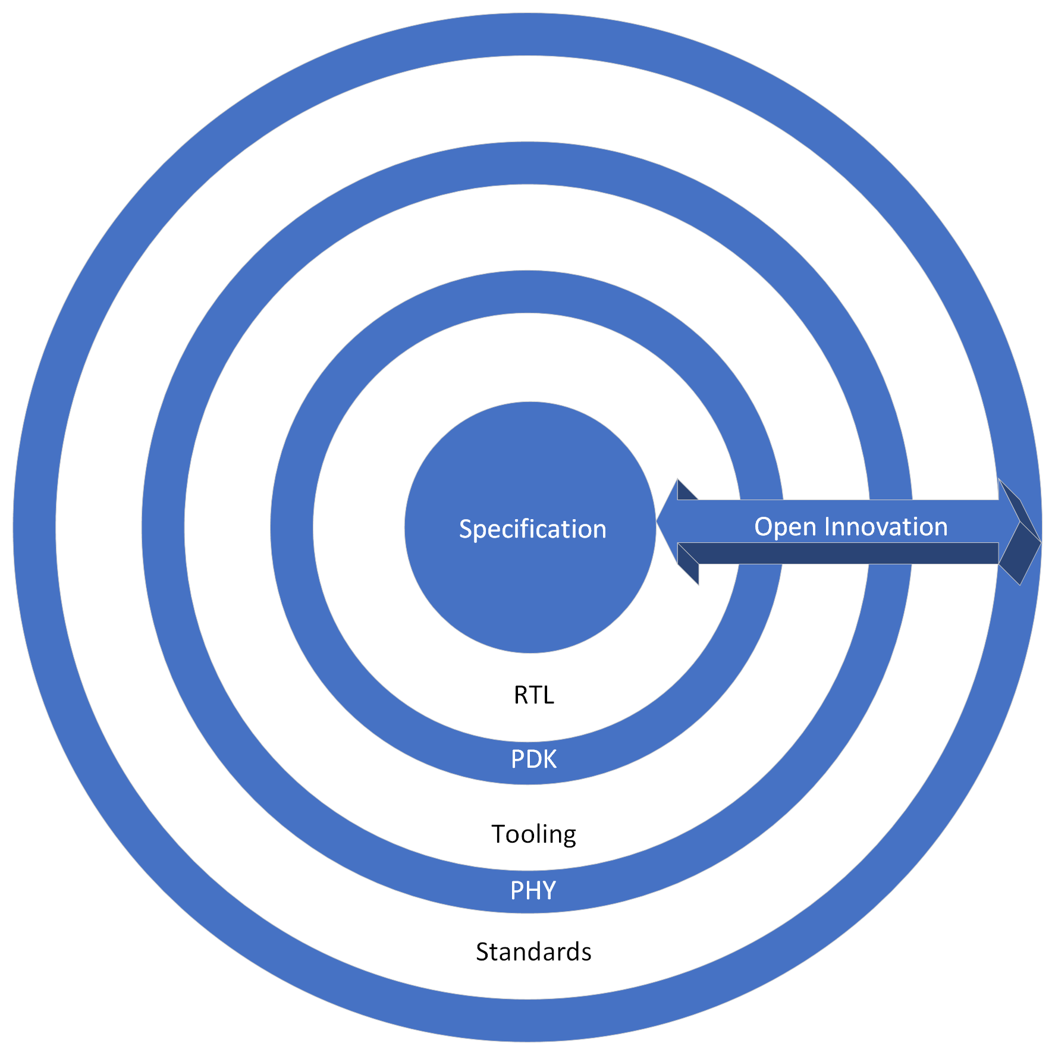
What is CHIPS Alliance About? Open Design Ecosystem
Many Participants
Individuals
Universities
Foundations
Industry
Notes:
CHIPS strives to create an open system of collaboration across the elements of silicon development with many different contributors. As in the software world, this will enable experts in different arenas to contribute, and other to leverage their strength.
Specification, Implementation, PDK, Tooling, PHY’s, Standards are some of the key areas.
There are many possible contributors to this ecosystem

Slide 5
Open Design Enablement with a Catalog of Trusted Ingredients
Open Source Verified and Trusted IP Component Library
Physical
Macro
Logical
Macro
Cell Library
Verification Testbench
Functional Simulation, Formal, Emulation
Analog Tools
Digital Tools
Design Data Representation
Arch
Implementation Framework
RTL
UVM
Props
Verification and Implementation Platforms
Notes:
To sum it all up, CHIPS Alliance as part of the Linux Foundation is working to create an open source, design enablement system with a catalog of trusted open source IP ingredients
The goal is to help accelerate community innovation and provide a way for differentiated product development on a much more rapid schedule than previously seen.

Slide 6

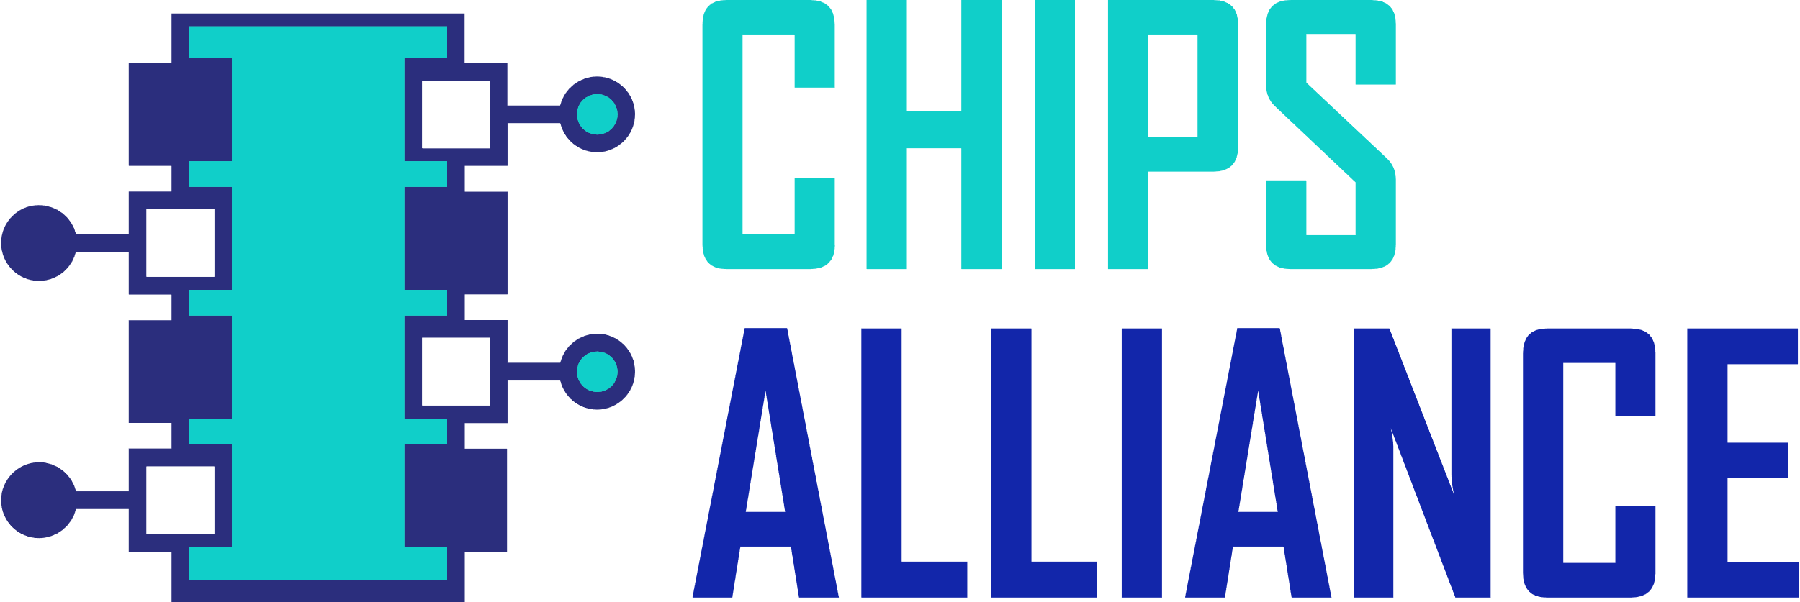
Workgroups
F4PGA
Chiplets
Design Entry
Rocket SoC
New Topics?
Cores
Tools
Analog

Slide 7
Putting it all Together: Open IP Community and Business Services
Community
Open Source
Repository
Seed
Developer
Community
Source Contribution
Release
Application Engineering
Service
Companies
A community to help you cook your secret sauce, Reduce Time to Market!
Notes:
This will allow new business opportunities to develop for
IP providers
EDA development / support companies

Slide 8
Technology Update Agenda

Slide 9
CHIPS 2022 Biannual
Technology Update
Rob Mains
General Manager
CHIPS Alliance
Email: rmains@linuxfoundation.org
Phone: +1 408 607 4879
March 12, 2022
Notes:
Hello:
My name is Rob Mains and I am general manager of CHIPS Alliance, which is part of the Linux Foundation.
As a nearly 40 year veteran in the chip development industry, with stints at IBM, Magma, Sun, Oracle, and Qualcomm,I have seen many trends and paradigms come and go, only to resurface again.. My experience covers both technical as well as executive management level stints.
Suffice to say, there have been many changes, but a continuing theme is change, particularly as it relates to innovation, productivity, cost, and time to market.
Similar as to what happened in software, open source hardware design offers new opportunities for collaboration, innovation, and product creation.
CHIPS Alliance has pillars of interest and associated workgroups across architecture, specification, reference implementation, interconnect, tools, FPGA, analog, verification, and artificial intelligence. Groups can spin up or down depending upon the challenges ahead.
Many ask what does my company have to provide in terms of IP. You don’t have to.
In fact, the level of participation is up to you, and can be done without even being a member of CHIPS. Our goal is to encourage collaboration.

